Slide 1

PA 57 Report
Informational Meeting
Comstock Township
Downtown Development Authority
February 27, 2025

Slide 2
PA 57 of 2018
Reporting Requirements to Improve Transparency
Maintain DDA Website
Hold Two Public Informational Meetings
Submit Annual Report to State of Michigan
Downtown Development Authorities are required to hold two informational meetings annually for the purpose of informing the public of the goals and direction of the authority, including projects to be undertaken in the coming year.

Slide 3
Comstock Center
Downtown Development Authority
In 2019, the Township created a Downtown Development Authority (DDA). You can find the map of the DDA boundaries below. This district enables the Township to capture property taxes from various taxing jurisdictions through Tax Increment Financing, which can then be utilized for enhancements within the district. The goal is to increase property values, stimulate economic growth, eradicate sources of deterioration, and rejuvenate the area’s vitality.
2023 Mission Statement: The Comstock Center DDA will aim to provide a friendly and welcoming downtown which will enhance and honor our history while promoting cultural, business and recreational opportunities that attract businesses and residents.

Slide 4
The Comstock Center Plan
The future success of the Township's efforts to revitalize Comstock Center hinges significantly on:
the readiness and capability of its public Boards and Administration.
the essential goal to implement public improvements that enhance the commercial space and actively support the development of new private ventures.
establish initiatives targeted to create jobs, attract new businesses, and generate additional tax revenues.

Slide 5
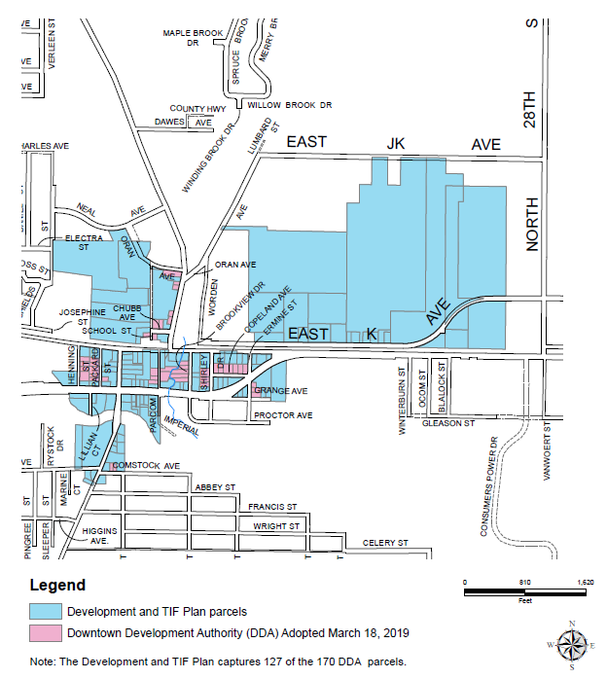
Comstock Center DDA and TIF Districts

Slide 6
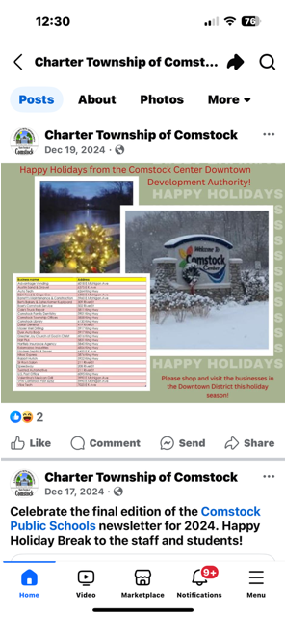
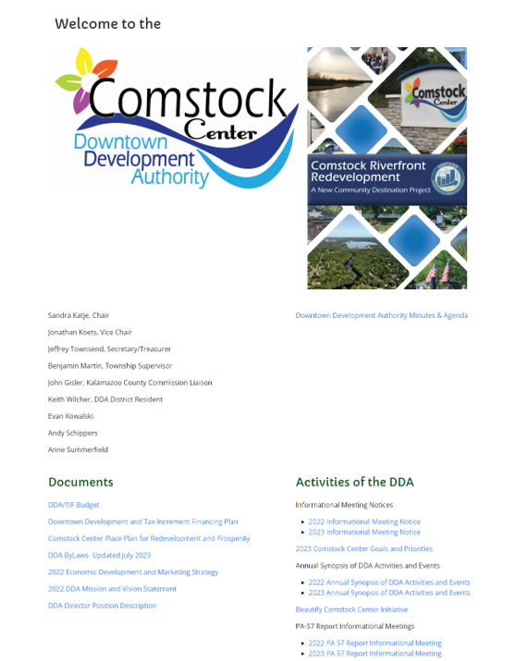
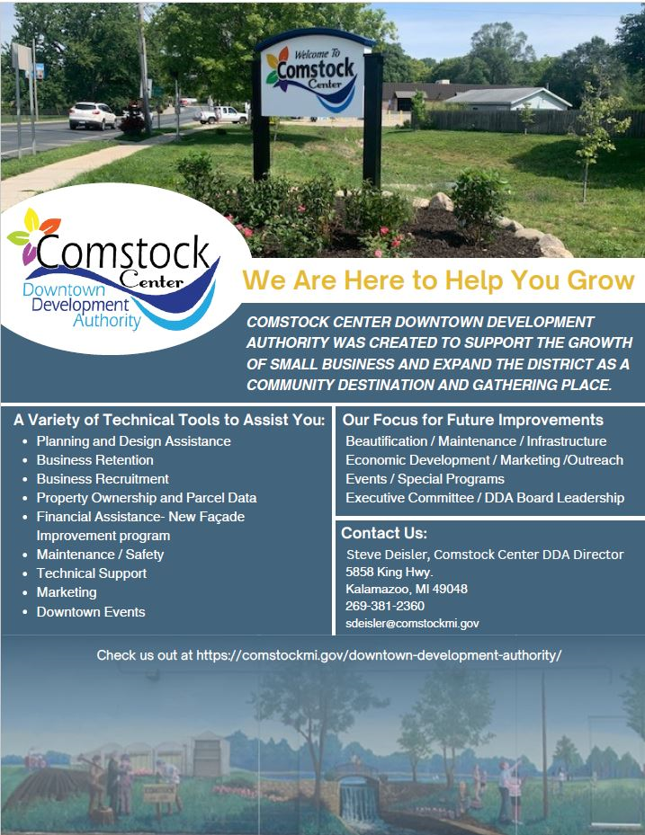
DDA Outreach / Social Media
DDA Monthly Meetings
DDA Website
  https://comstockmi.gov/downtown-development-authority/
Township Facebook &
Newsletter
Direct Mailing
Business Visits
Hand Delivered Project
Flyers

Slide 7
Comstock Center Board / Committee Goals and Objectives – 2023 / 2024
Beautification / Maintenance / Infrastructure / Safety
Events / Special Programs
Economic Development / Marketing / Outreach
Executive Committee

Slide 8
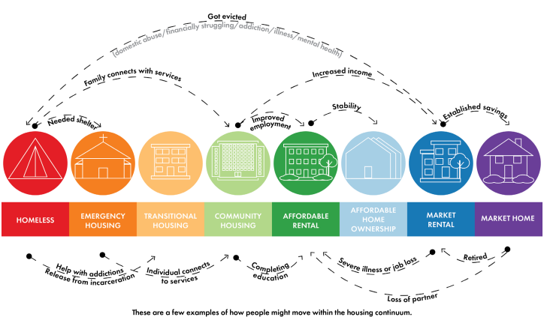
Comstock Center DDA –
Short Term Priorities – Accomplishments 2023/2024
Board Membership & Involvement - 32 Board and Committee Meetings.
Grant Funding / Market Comstock Center - 6 grants awarded.
Façade Improvement Program – 2 applications processed
Beautify Comstock / Maintenance / Business Partnerships - expanded landscaping and holiday decorations.
2023 Events – Memorial Day, National Night Out, Paddle & Pour New Event - 7
Phase 1 Comstock Riverfront Redevelopment Project
Environmental Assessment , Target Market Analysis, Revise Land Use and Design plans, Appraisal / Land Acquisition, Funding Plan / Proforma
Joint Resolution of Support Approved 11/8/24 by Township Board and DDA Board for the Riverfront Redevelopment Plan
Assist with the Township 2025 Housing Plan

Slide 9
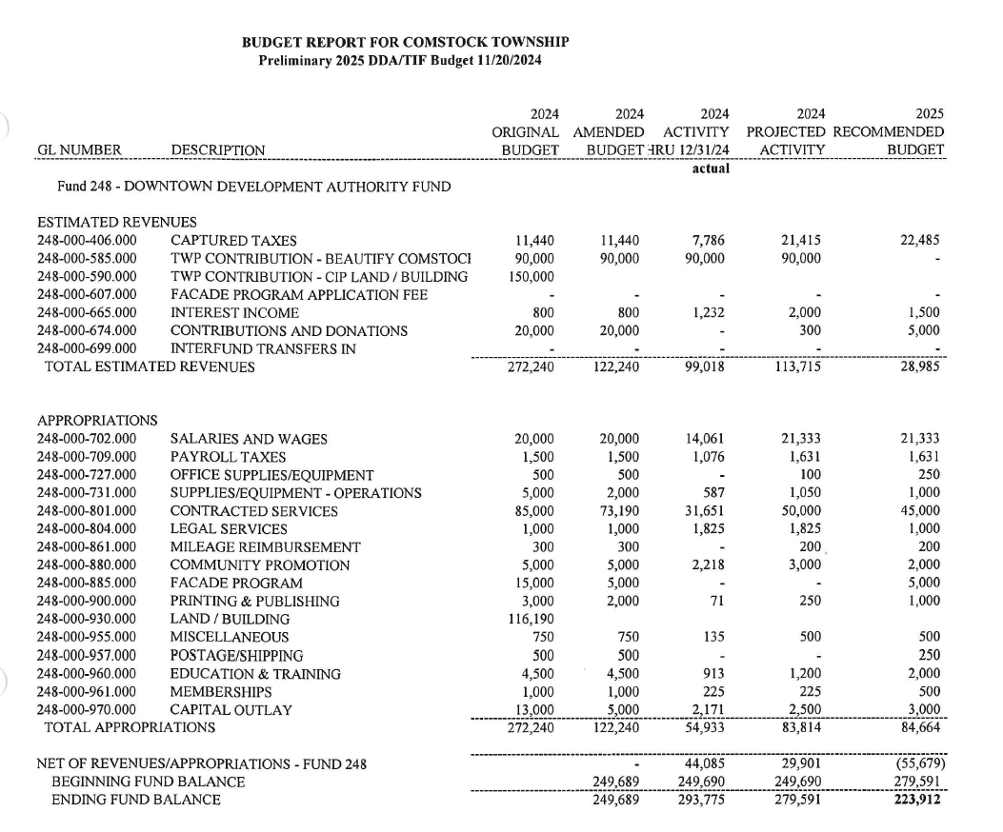
Comstock Center
December 2024 DDA/TIF Budget
B
2024 Budget Highlights:
TIF increased by $10,000.
Required budget amendment
reduced revenues by $150,000.

Slide 10
DDA Participation & Partnerships
Technical -Kalamazoo County, MEDC, EPA
Governmental - Township Board and Staff, Parks & Recreation, Road Commission, Michigan Waterways Stewards
Businesses - Wenke Greenhouses, River St Flowerland, Sportel Greenhouse, Comstock Dentistry, Hartlieb Insurance, Valentina’s, Niko’s Cafe, Rabbitt Hutch
Financial - Callander Commercial.
Community Foundations - Irving S. Gilmore, ITC, Consumers Energy

Slide 11
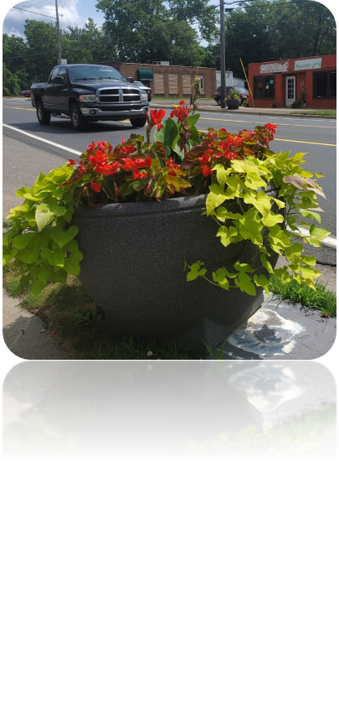
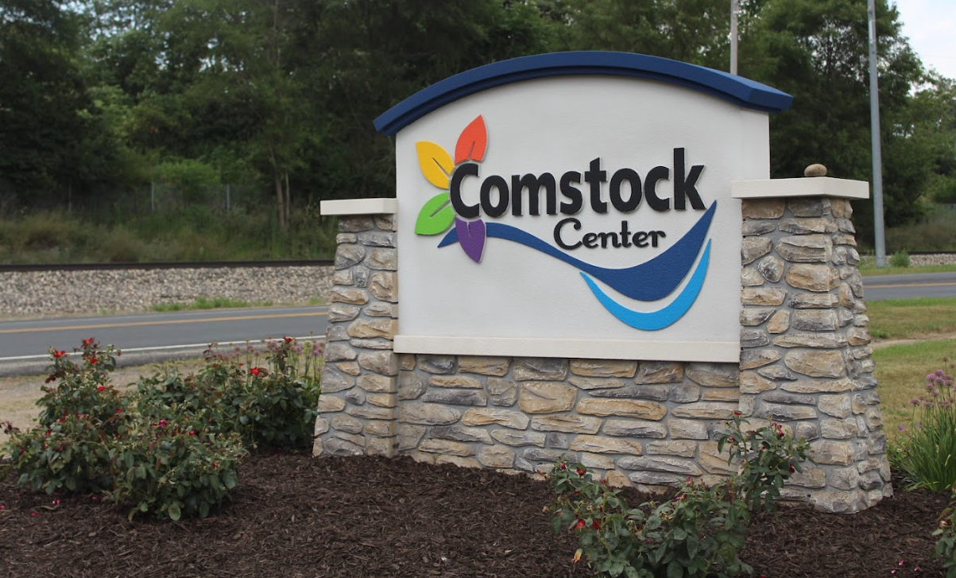
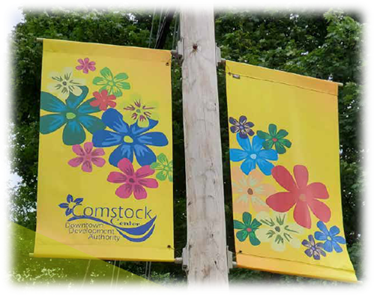
2024 Projects - Beautify
Expansion of the Beautify Comstock Center initiative.
  Five gateways and
  36 flower planters
  8 Trash Containers on King Hwy. and on River St.

Slide 12
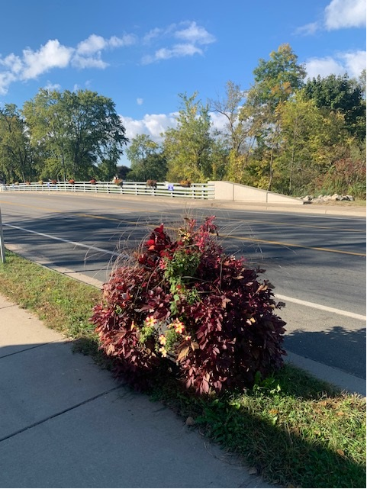
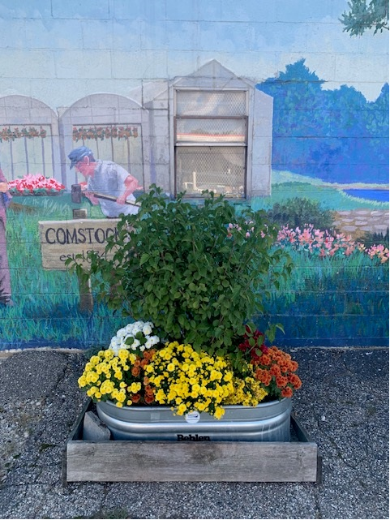
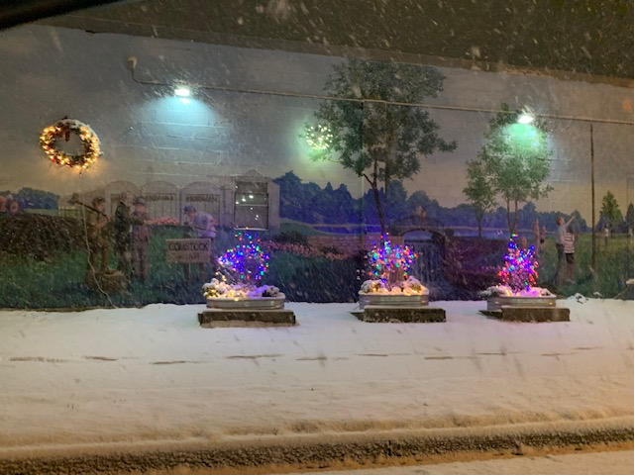
2024 Projects - Beautify
Supported National Night Out, Fall Fest, Holiday Tree Lighting.
Initiated new event - Summer Paddle & Pour.
Added new landscaping and decorations to Downtown.

Slide 13
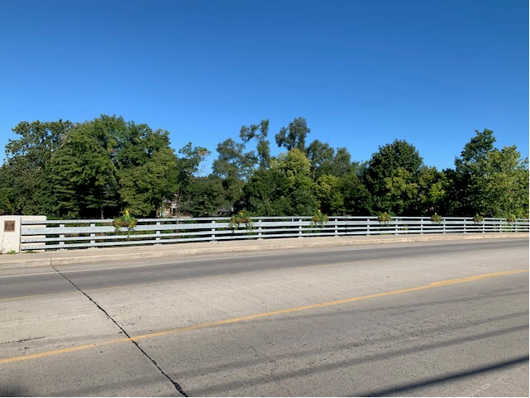
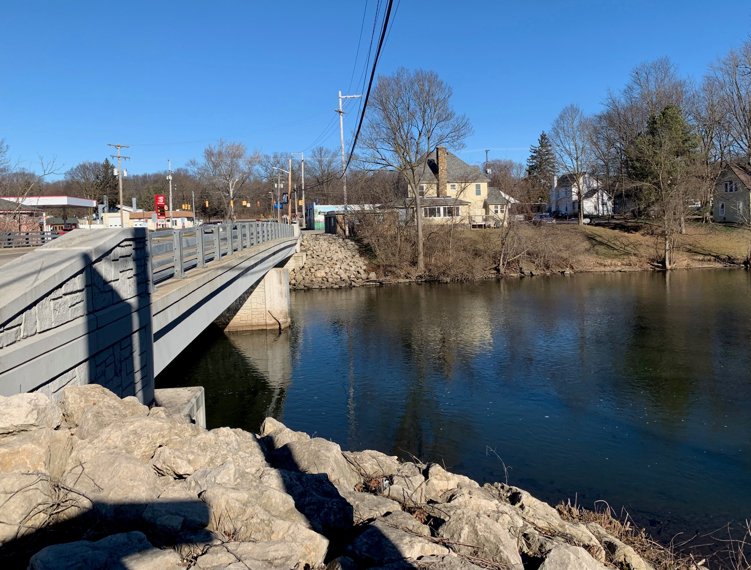
2024 Projects - Beautify
The Kalamazoo River Bridge Flower Program was installed. A new security camera and signage was installed to help prevent vandalism
Annual Bridge bank clean-up was completed.

Slide 14
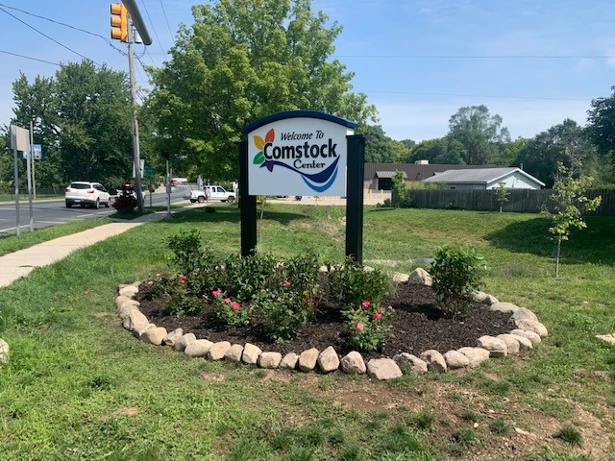
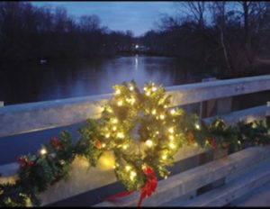
2024 Projects – Beautify
MowCo completed their second successful contract year for planter (36) and gateway (5) maintenance.
Holiday decorations were added to the bridge and gateways.

Slide 15
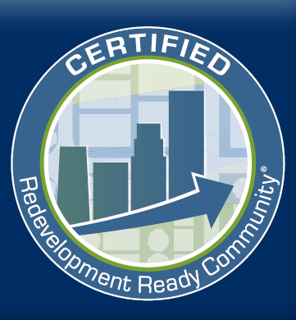
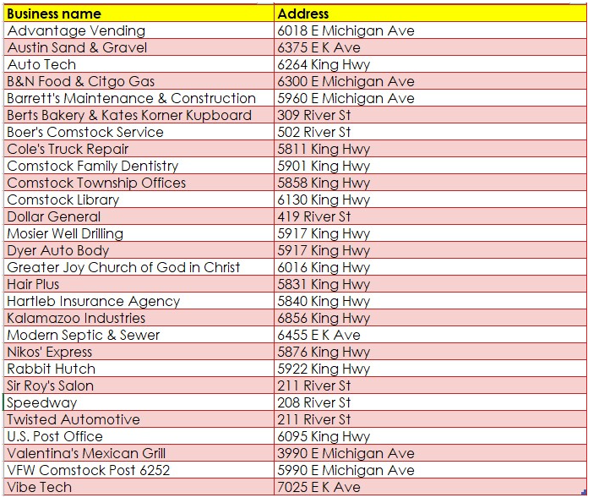
2024 Projects – Economic Development
Riverfront Redevelopment Plan: Pre Development Actions – Completed environmental assessments, market assessments, site plan concept plan and property appraisals.
Grant awards – 2 grants awarded
Business Retention / Recruitment Outreach – Continued meetings with 10 business owners/tenants. Completed DDA Commercial Business Inventory.

Slide 16


2024 Grants
DDA was awarded and utilized a $5,000 grant from ITC to fund the Façade Improvement Program.
DDA was awarded a $100,000 grant from the Irving S. Gilmore Foundation for the Riverfront Redevelopment Plan. A $45,000 match must be raised locally to receive the ISG funds.
$32,000 grant from the Kalamazoo County BRA for the environmental site assessments at the corner of King Hwy. and River St. Completed
$35,000 application submitted to MEDC / Redevelopment Ready Certification Program for Predevelopment Studies Completed
For Economic Development initiative:
  Completed Application to ISG Foundation for Riverfront Enhancement Plans. The DDA was awarded a $100,000 contingency grant pending further local match funds.
  $10,000 from ITC Foundation, a two-year program award to assist the Facade Improvement Program. Funds Still Available through 2025

Slide 17
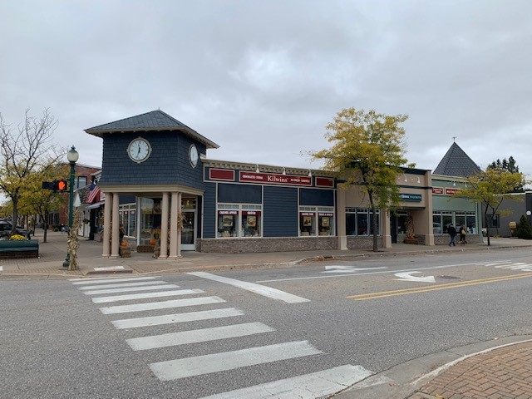
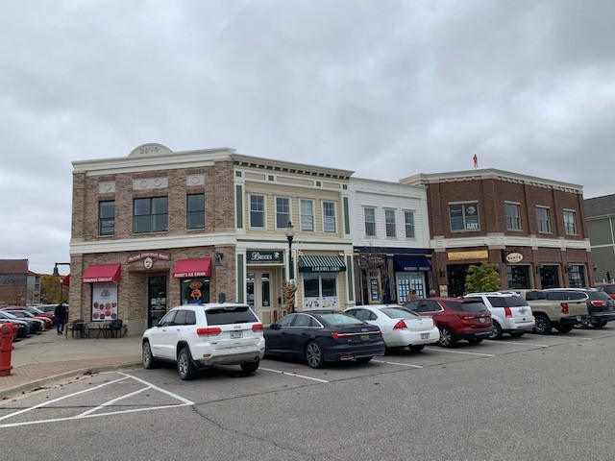
2024 Projects – Economic Development

Slide 18
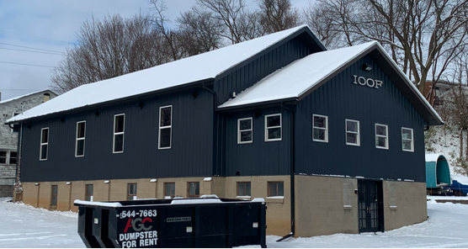
2025 Targeted Goals
Greater focus on Economic Development - Riverfront Redevelopment Plan – Phase 2
Façade Improvement Program – Target 3 new applicants
Affordable Housing / Homelessness – Create a Rehab Grant Program
Business Recruitment -
Fill 2 Vacant Retail Spaces
Maintenance / Security –
Develop a Clean and Safe Plan
Community Open House/
Townhall Meeting
Lofts on Riverside – Four apartment lofts
under construction (26th St. and Chubb Ave.)

Slide 19
Meetings &
Contact Information
The Comstock Center DDA meets on the fourth Wednesday of the month at 5:30 p.m.
Steve Deisler, Executive Director
Comstock Center Downtown Development Authority
Email: sdeisler@comstockmi.gov
DDA Webpage: https://comstockmi.gov/downtown- development-authority/
  Phone: 269-381-2360

Slide 20
Be Involved!

