Slide 1

PA 57 Report
Informational Meeting
November 20, 2023

Slide 2
Comstock Center
Downtown Development Authority
The Township established a Downtown Development Authority (DDA) in 2019. A map of the DDA boundaries is below. The DDA district allows the Township to capture taxes from other taxing jurisdictions through Tax Increment Financing and use them for improvements within the boundaries of the district to increase property values, promote economic development, eliminate causes of deterioration and improve the vitality of the area.
Mission Statement: The Comstock Center DDA will aim to provide a friendly and welcoming downtown which will enhance and honor our history while promoting cultural, business and recreational opportunities that attract businesses and residents.

Slide 3
PA 57 of 2018
Reporting Requirements:
Maintain DDA Website
Submit Annual Report to State of Michigan
Hold Two Informational Meetings
Downtown Development Authorities are required to hold two informational meetings annually for the purpose of informing the public of the goals and direction of the authority, including projects to be undertaken in the coming year.

Slide 4
PA 57 Act TIF and Development Plan Directives
The goals and direction of the Comstock Center DDA are defined by the Tax Increment Financing (TIF) and Downtown Development Plan adopted by the Township Board in 2019 (available on webpage).
GOALS:
  Economic Development
  Eliminate Blight
  Historic Preservation
  Promote Growth

Slide 5
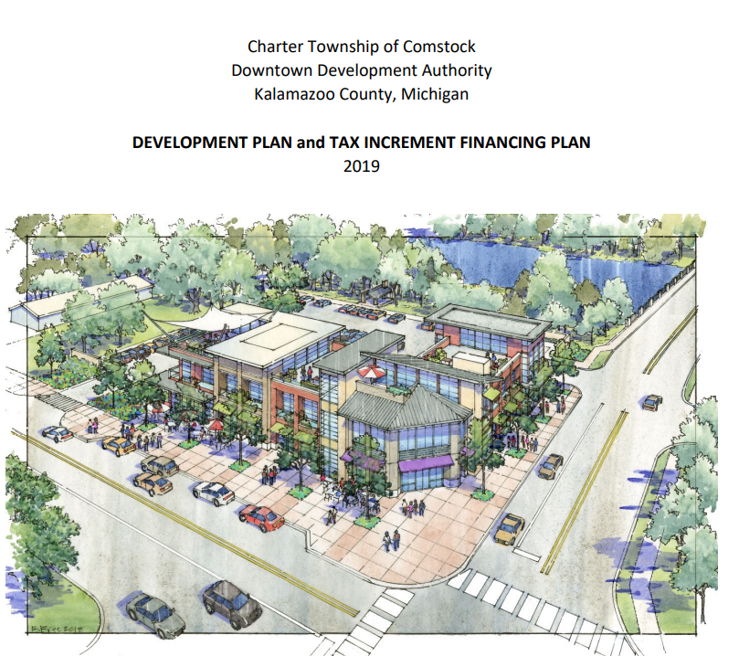
2019 TIF and Development Plan

Slide 6
The Comstock Center Plan
The future success of the Township’s efforts to revitalize its commercial area will depend, in large measure, on the
readiness and ability of its public corporate entity to
initiate public improvements that strengthen the
commercial area, and to encourage and participate where feasible in the development of new private uses that
clearly demonstrate the creation of new jobs, the attraction of new business, and the generation of additional tax
Revenues.

Slide 7
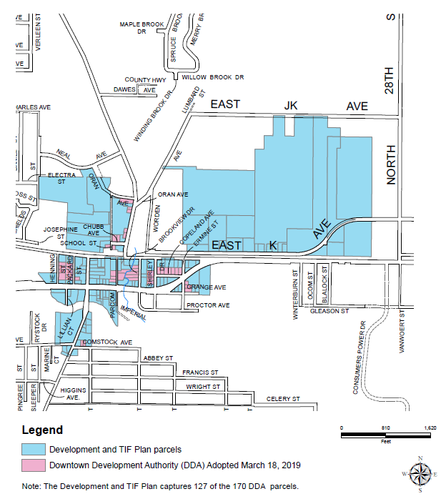
Comstock Center DDA and TIF Districts

Slide 8
Board of Directors - 2023
Sandra Katje, Chair
Jon Koets, Vice Chair
Jeffrey Townsend, Secretary/Treasurer
Randy Thompson, Township Supervisor
John Gisler, County Commissioner
Evan Kowalski
Matt Norman
Anne Summerfield
Resident Representative (vacant)

Slide 9
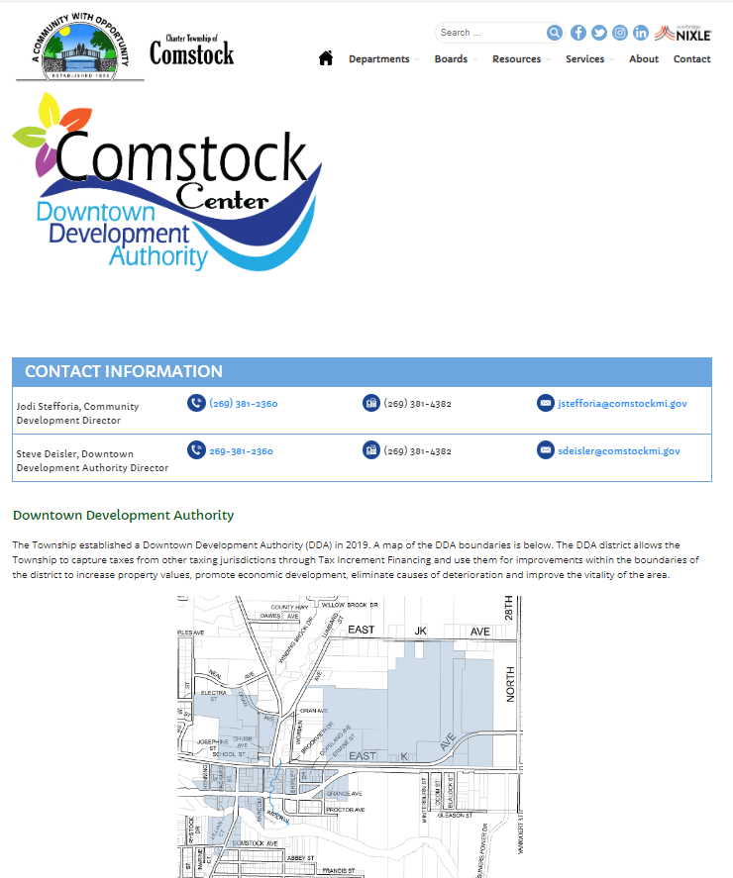
DDA Webpage
https://comstockmi.gov/downtown-development-authority/

Slide 10
Comstock Center Goals and Objectives – April 2023
Beautification / Maintenance / Infrastructure
Events / Special Programs
Economic Development / Marketing / Outreach
Executive Committee

Slide 11
Comstock Center DDA –
Short Term Priorities - 1 to 2 years
Board Membership & Involvement
Grant Funding / Market Comstock Center
Beautify Comstock / Maintenance / Business Partnerships
2023 Events – Memorial Day, National Night Out, New Event
Comstock Riverfront Redevelopment Project
  Environmental Assessment / Target Market Analysis
  Appraisal / Land Acquisition
  Funding Plan / Proforma
  Revise Land use and design plans

Slide 12
Comstock Center DDA –
Long Term Priorities - 3 to 5 years
Comstock Riverfront Redevelopment Project
  Finalize Design & Funding Plans – Building, Riverfront, Streetscape, Trailway
  Select Developer / Sign Agreements
  Begin Demolition & Construction / Complete Project
Phase 2 - Streetscape Plans (River St and King Hwy)
Support & Implement the Comstock Twp. Housing Program
Historic Preservation – Comstock House

Slide 13
Comstock Center
August 2023 DDA/TIF Budget
.

Slide 14
DDA Participation & Partnerships
Technical
Governmental
Businesses
Financial
Residents

Slide 15
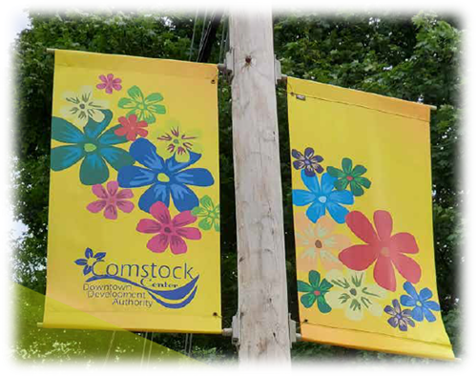
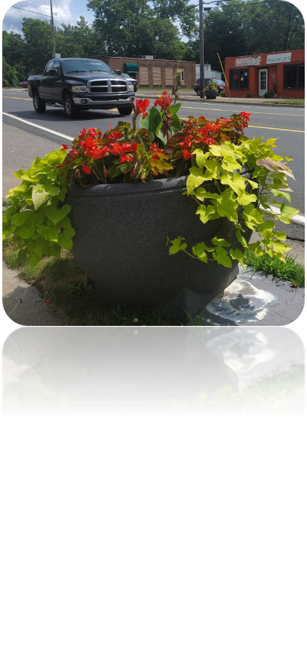
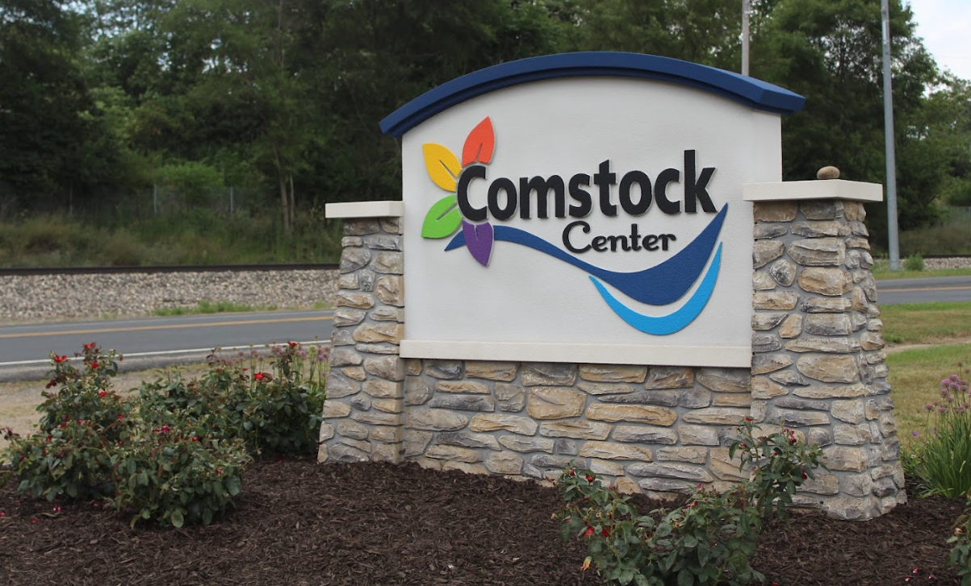
2023 Projects - Beautify
Expansion of the Beautify Comstock Center initiative.

Slide 16
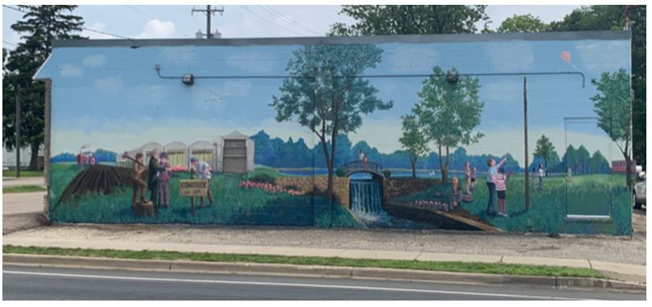
2023 Projects - Events
Supported National Night Out and expanded Fall Fest with Parks & Rec. – Both events saw increased attendance
Restoration of
the 2005
Downtown
Mural

Slide 17
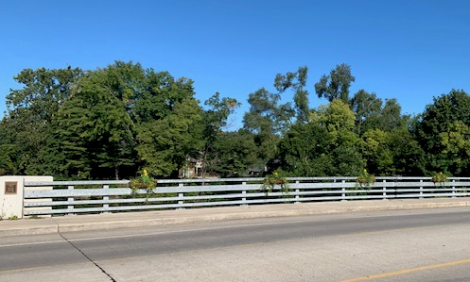
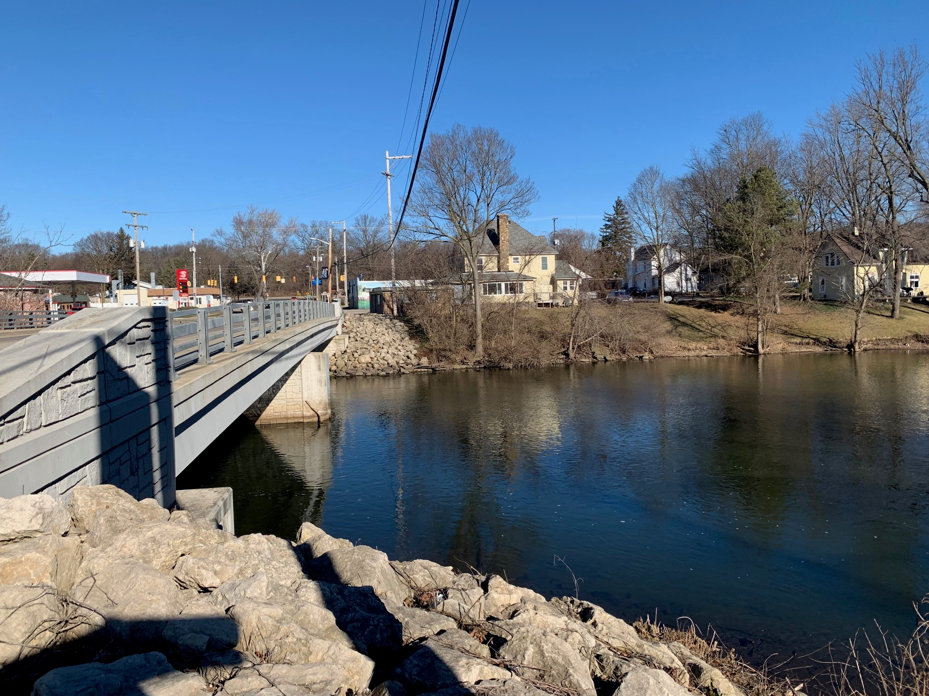
2023 Projects - Events
Re-established the Kalamazoo River Bridge Flower Program
MowCo. completed Bridge bank clean-up

Slide 18
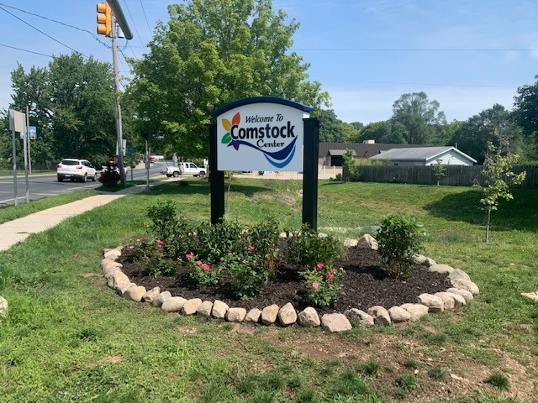
2023 Projects - Events
Added a 5th Downtown Gateway sign on River St. and Comstock Ave.

Slide 19


2023 Projects – Economic Development
Place Plan Predevelopment Studies – 3 studies underway
Grant awards – 6 grants awarded
Business Retention / Recruitment Calls – 15 business owners/tenants

Slide 20
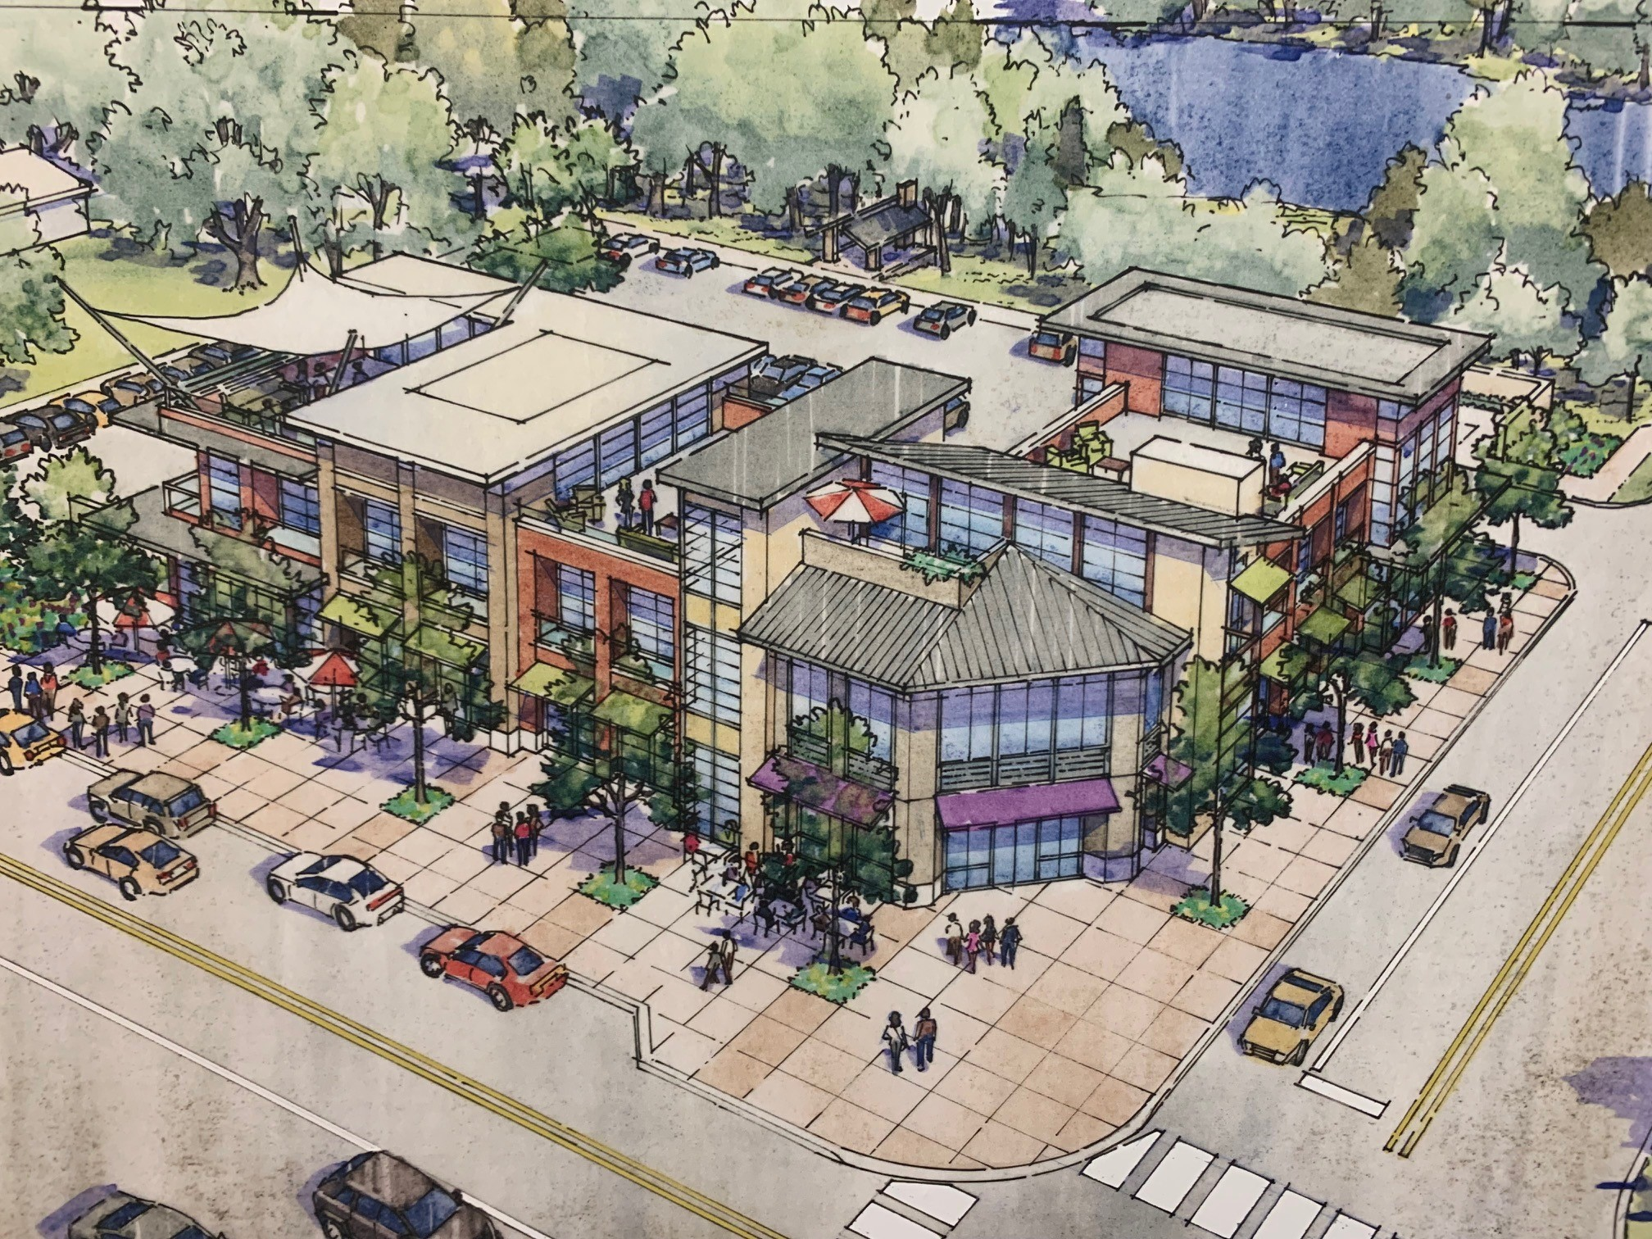
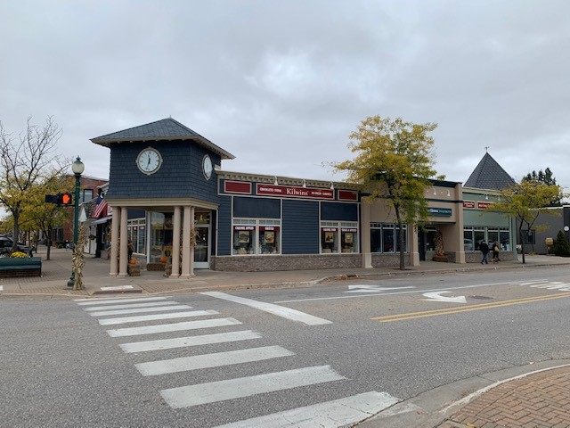
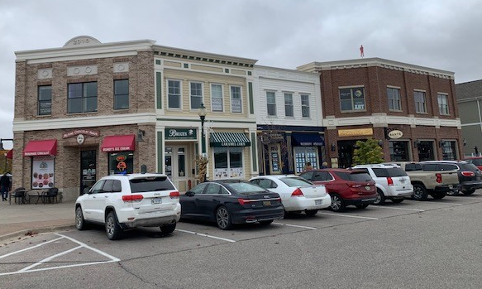
2023 Projects – Economic Development

Slide 21
2023 Projects – Economic Development
Creation of the Comstock Center Façade Improvement Program – reach out to 4 businesses.

Slide 22
2023 Projects – Executive Committee
Approved two new members to the Board.
Hired new Part-time DDA Director April 2023.
Amended by-laws to streamline accounting and payment process.
Board Members involvement in Committees

Slide 23
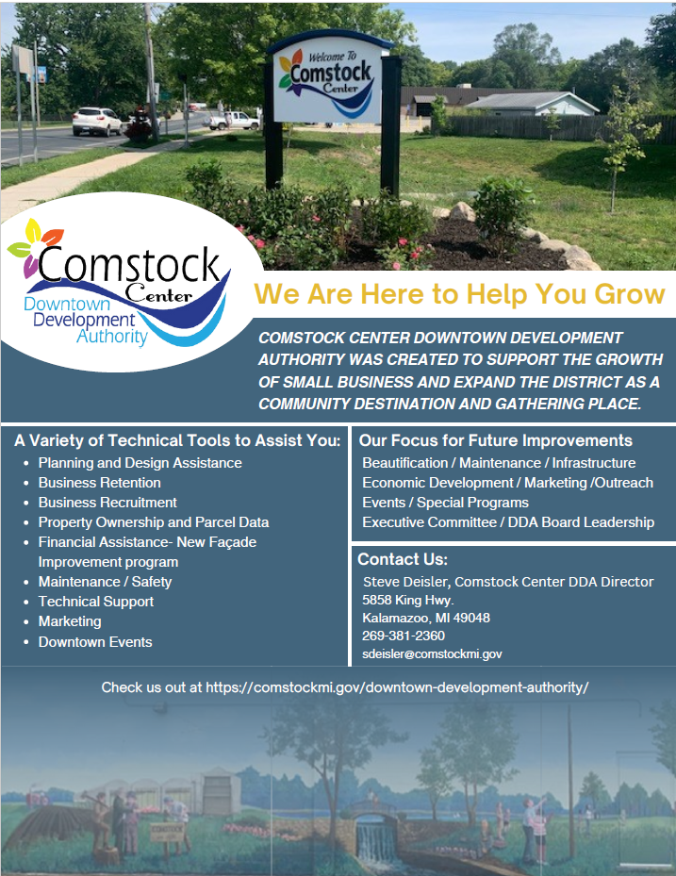
2023 Outreach / Training
A Business Assistance Newsletter and Brochure were created to inform and educate businesses and visitors about Comstock Center DDA support services.

Slide 24
2023 Outreach / Training
DDA Director attended two Michigan Downtown Association conferences.
Held a variety of Committee meetings at local businesses
Weekly site visits to Retailers.
Building relationships with contractors / consultants.

Slide 25
Grants
$32,000 grant from the Kalamazoo County BRA for the environmental site assessments at the corner of King Hwy. and River St.
$35,000 application submitted to MEDC / Redevelopment Ready Certification Program for Predevelopment Studies.
For Beautify Comstock Center initiative:
  $2,500 from Consumers Energy Foundation
  $10,000 from ITC Foundation a
  two-year program award.

Slide 26
Donations
Support and donations from the local Greenhouses (Wenke, River St. Flowerland and Sportel) Beautify Comstock Center initiative.
Two Comstock Center businesses donated dollars for National Night Out and Fall Fest events.
Held First Comstock Clean-up Day in May 2023.

Slide 27
Awards
Received the 2021 Planning Excellence Award from the Michigan Association of Planning for the Comstock Center Place Plan for Prosperity and Redevelopment.

Slide 28

Learn More about DDAs
The Michigan Downtown Association offers a series of webinars about DDAs.
Informative for elected and appointed officials!
Contact Steve Deisler for the link to watch the webinars.

Slide 29
Meetings &
Contact Information
The Comstock Center DDA meets on the fourth Wednesday of the month at 5:30 p.m.
Steve Deisler, Executive Director
Comstock Center Downtown Development Authority
Email: sdeisler@comstockmi.gov
Webpage: www.comstockmi.gov
Phone: 269-381-2360

Slide 30
Thank you!

