Slide 1
Informational Meeting September 28, 2022 v.2

Slide 2
PA 57 of 2018
Informational Meetings
Downtown Development Authorities are required to hold informational meetings annually for the purpose of informing the public of the goals and direction of the authority, including projects to be undertaken in the coming year.

Slide 3
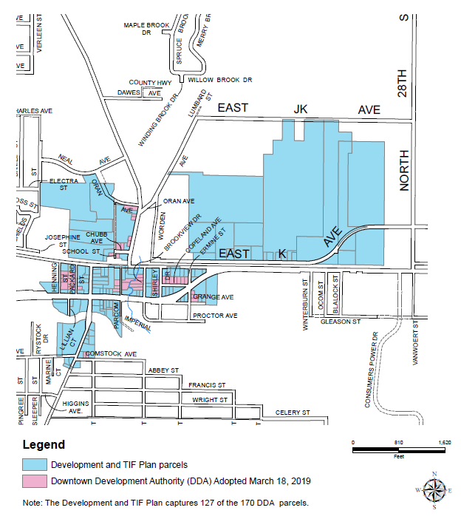
Map of DDA Area

Slide 4
Comstock Center Name & Logo
Comstock Center refers to the downtown area only.
Since at least the 1970s, records reflect that this area was referred to as Comstock Center and there have been discussions for decades about how to revitalize it.
The Township established the DDA in 2019 for this purpose.

Slide 5
Comstock Center Name & Logo
The DDA worked with a designer to prepare the Comstock Center logo.
The Comstock Center name and the logo are for branding and marketing purposes.

Slide 6
TIF and Development Plan
The goals and direction of the Comstock Center DDA are defined by the Tax Increment Financing (TIF) and Downtown Development Plan adopted by the Township Board in 2019 (available on webpage).
GOALS:
Economic Development
Eliminate Blight
Historic Preservation
Promote Growth

Slide 7
Board of Directors - 2023
Sandra Katje, Chair
Jon Koets, Vice Chair
Jeffrey Townsend Secretary/Treasurer
Randy Thompson, Township Supervisor
John Gisler, County Commissioner
Ryan Davis
Evan Kowalski
Matt Norman

Slide 8
DDA Webpage
https://comstockmi.gov/downtown-development-authority/

Slide 9
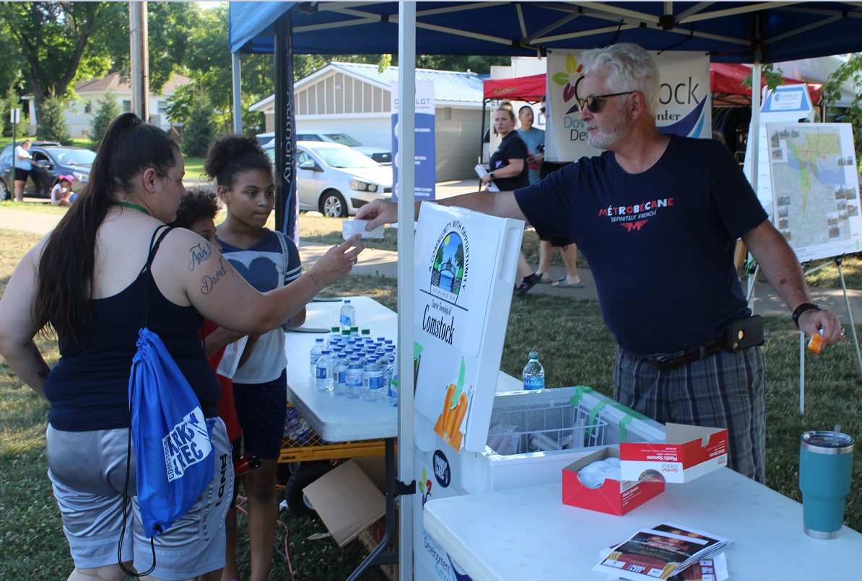
DDA Participation
Representation on the Economic Development, Marketing & Branding Strategy Steering Committee.
National Night Out at Merrill Park with the Kalamazoo County Sheriff’s Department including a food truck, water and ice cream.

Slide 10
DDA Participation (cont’d)
Redevelopment Ready Community Certification Event.
Movie Night at Merrill Park.

Slide 11
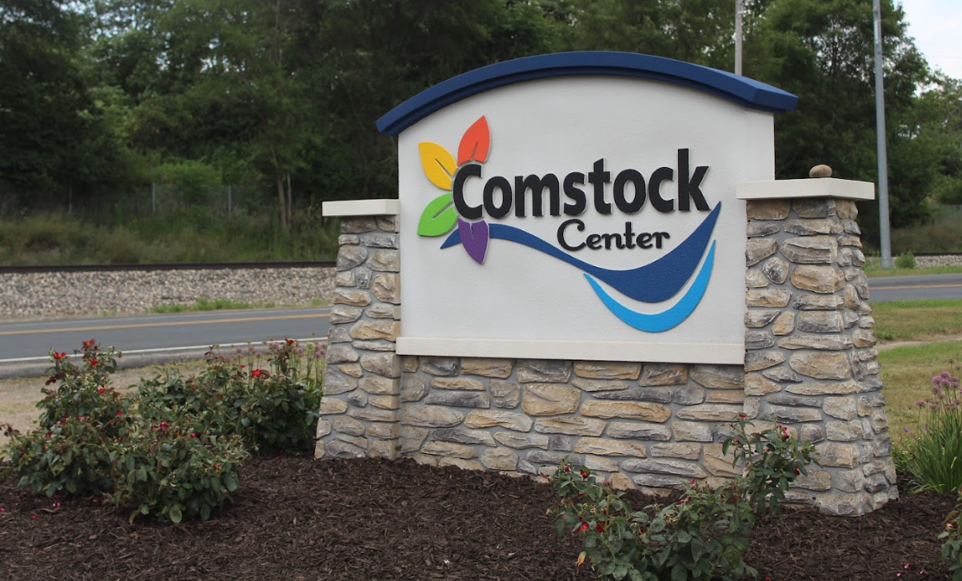
2022 Projects
Began implementing the Beautify Comstock Center initiative toward a full downtown revitalization plan.
Established four welcoming gateways to Comstock Center with signs and plantings.

Slide 12
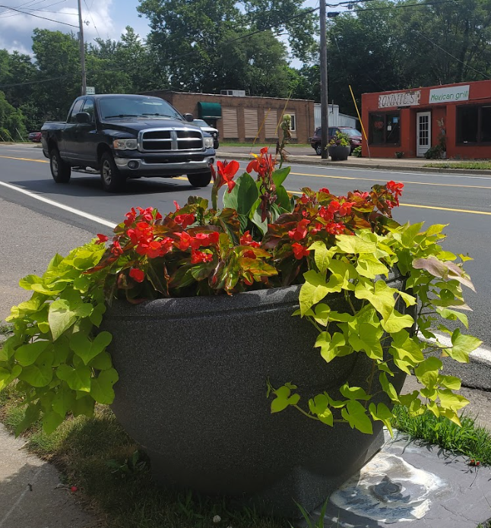
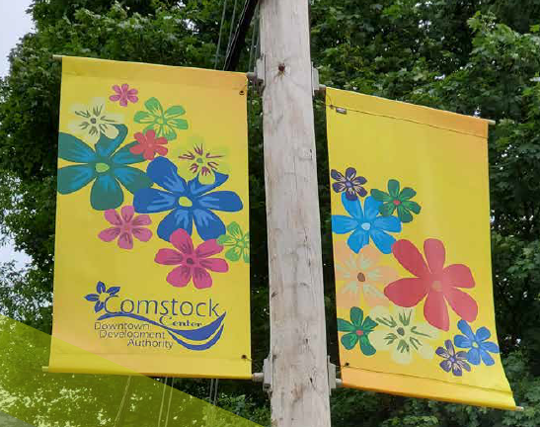
2022 Projects (cont’d)
Contracted the placement and maintenance of 30 planters around Comstock Center and the gateways.
Seasonally changed banners in Comstock Center.

Slide 13
2022 Projects (cont’d)
Cut back the overgrowth on the four quadrants of and along the sidewalk of the River Street bridge over the Kalamazoo River.
Formalize duties and tasks of the DDA Board members and Director.
Preparing Vision and Mission Statements to guide activities of the DDA Board.

Slide 14
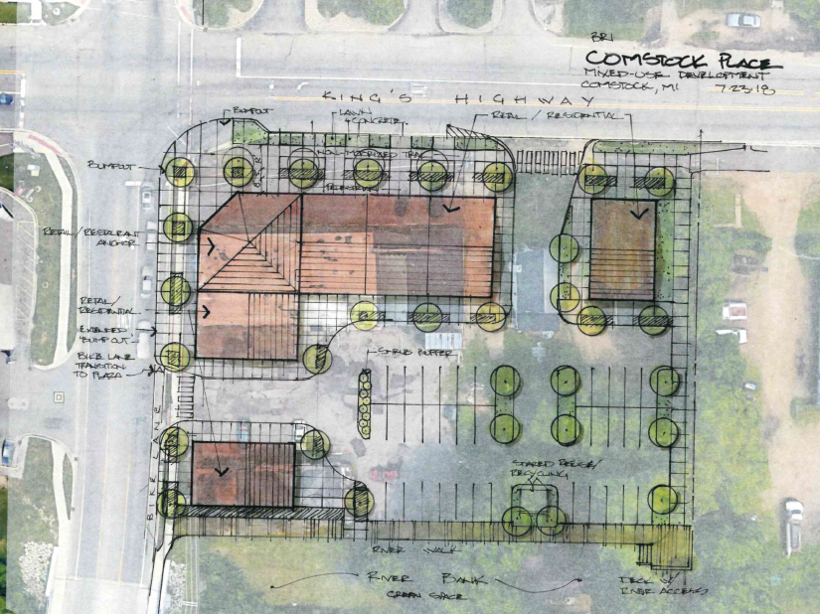
2023 Projects
Along with Township, work with MEDC on the marketing, funding, and designs for a priority redevelopment site in Comstock Center.

Slide 15
2023 Projects (cont’d)
Focus on implementing DDA elements of the Economic Development, Marketing & Branding Strategy.
Available at: https://comstockmi.gov/economic-development/

Slide 16
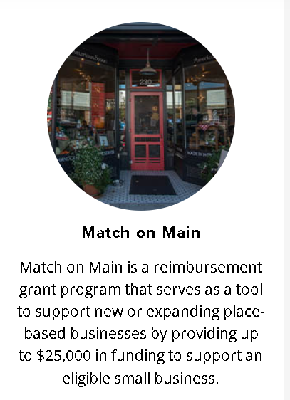
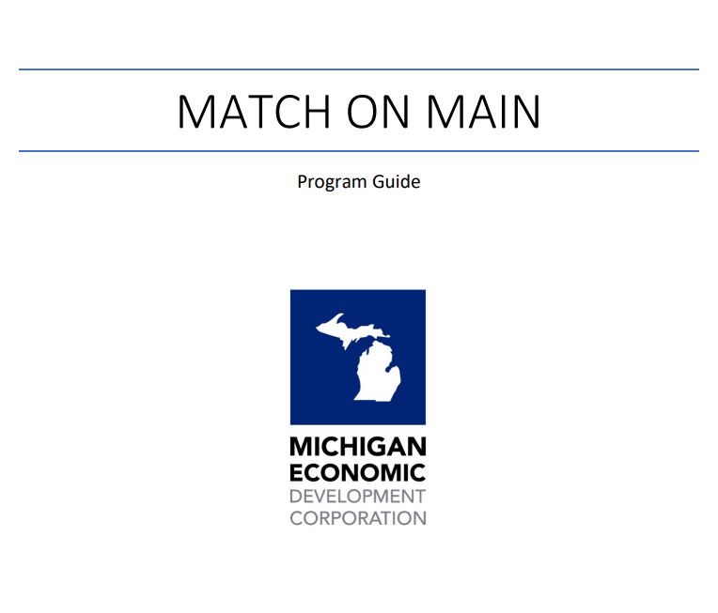
2023 Projects (cont’d)
Partner with Comstock Center businesses and property owners for various grant opportunities available to them now that Township is a RRC community.
Continue efforts that implement the Beautify Comstock Center initiative.
Prepare a multi-year capital improvement program.

Slide 17
2023 Projects (cont’d)
Pursue additional grants and donations.
Establish a Comstock Center DDA social media presence.
Place and maintain planters & maintain the gateways.
Seasonally swap the banners.

Slide 18
Grants
$21,000 grant from the MEDC for the creation of an economic development marketing & branding strategy with the Township.
For Beautify Comstock Center initiative:
$10,000 from Irving S. Gilmore Foundation
$10,000 from Consumers Energy Foundation
$5,000 from Harold & Grace Upjohn Foundation

Slide 19
Donations
$29,000 planter donation from Landscape Forms for the Beautify Comstock Center initiative.
Soil donation from Michigan Grower Products for the planters placed around Comstock Center.
Weekend maintenance of gateway plantings by CD Lawn & Maintenance.

Slide 20
Awards
Received the 2021 Planning Excellence Award from the Michigan Association of Planning for the Comstock Center Place Plan for Prosperity and Redevelopment.

Slide 21
Learn More about DDAs
The Michigan Downtown Association offers a series of webinars about DDAs.
Informative for elected and appointed officials!
Contact Steve Deisler for the link to watch the webinars.

Slide 22
Meetings & Contact Information
The Comstock Center DDA meets on the fourth Wednesday of the month at 5:30 p.m.
Steve Deisler, Executive Director Comstock Center Downtown Development Authority
Email: sdeisler@comstockmi.gov
Webpage: www.comstockmi.gov
Phone: 269-381-2360

Slide 23
Thank you!

